Slide 1


TRAINING DAY 4

Slide 2
AGENDA
SAP Data Migration using BODS
Data Migration concepts
About SAP and their products in Data Migration
Different kind Data Migration techniques
Customer Case study
Accelerated S/4HANA data migration powered by DataPath

Slide 3
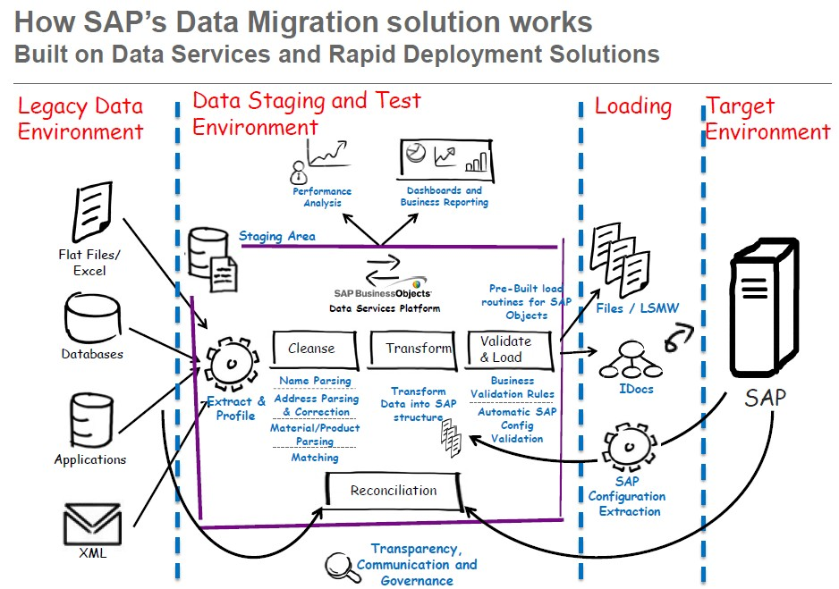
SAP DATA MIGRATION USING BODS

Slide 4
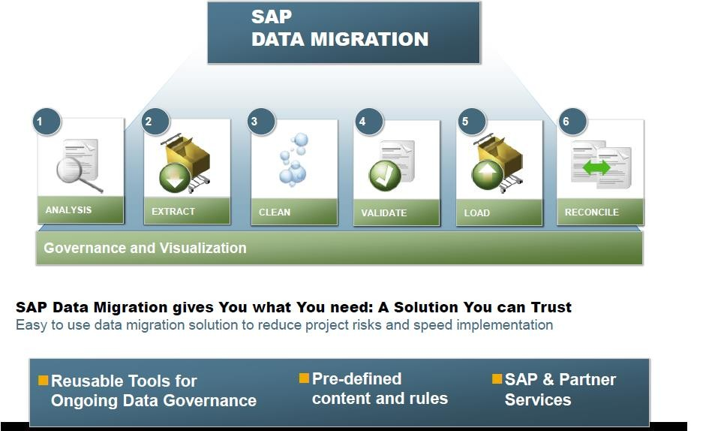
SAP Data Migration

Slide 5
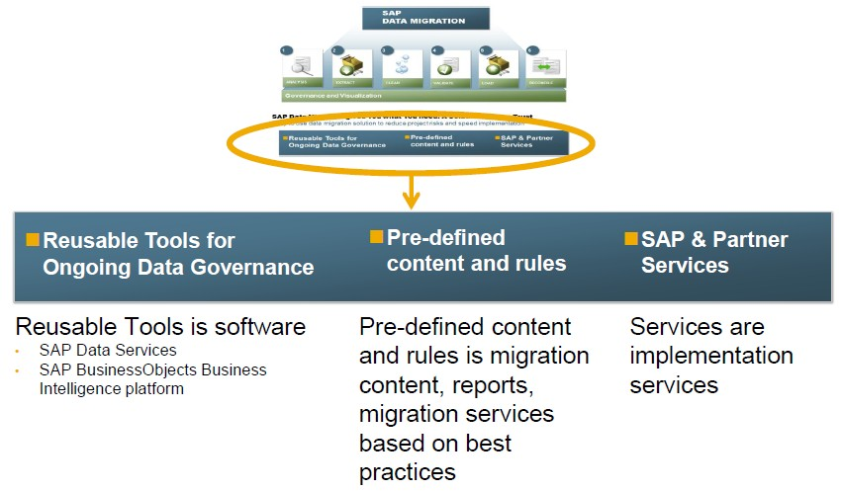
What you get with SAP’s Data Migration solution

Slide 6
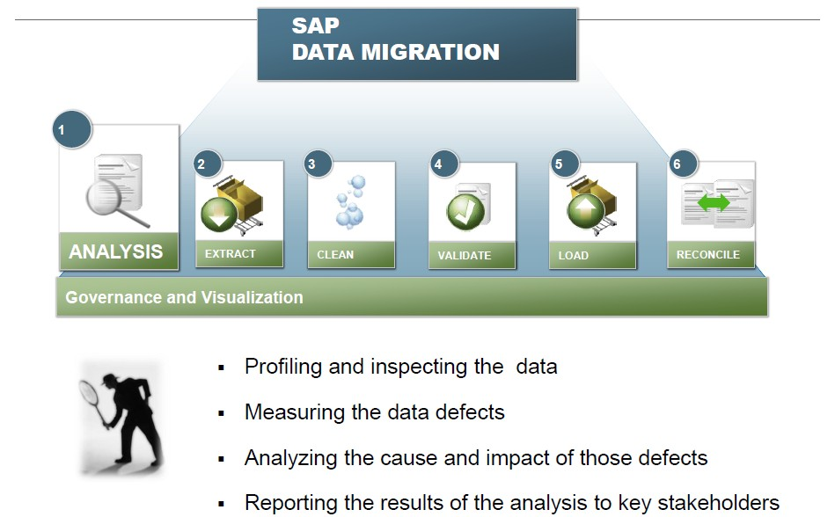
SAP DATA MIGRATION SOLUTION ANALYSIS & DATA PROFILING

Slide 7
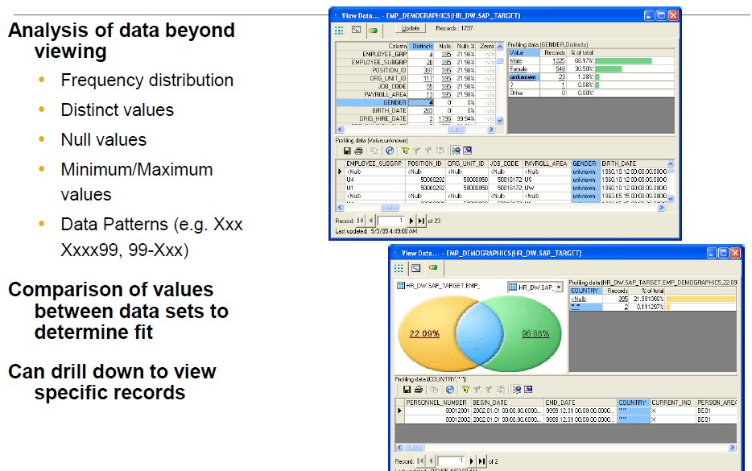
Data analysis and profiling analyzes data content, quality, structure and relationships

Slide 8
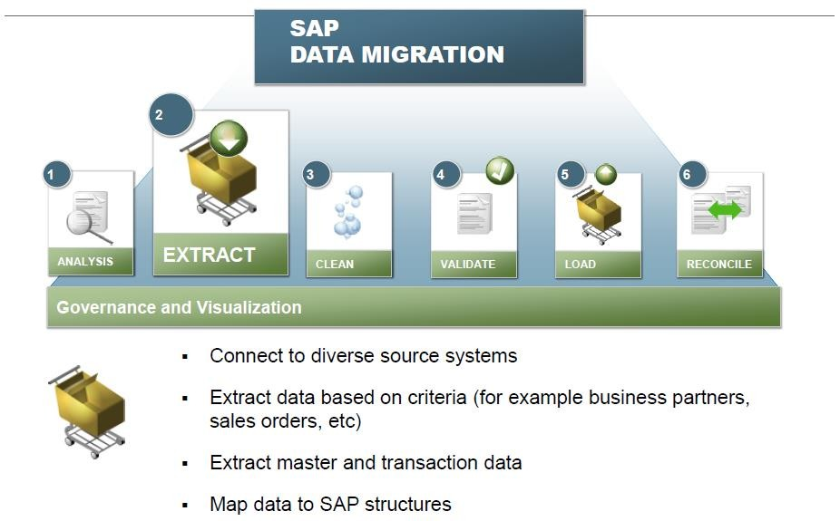
SAP Data Migration solution Extraction

Slide 9
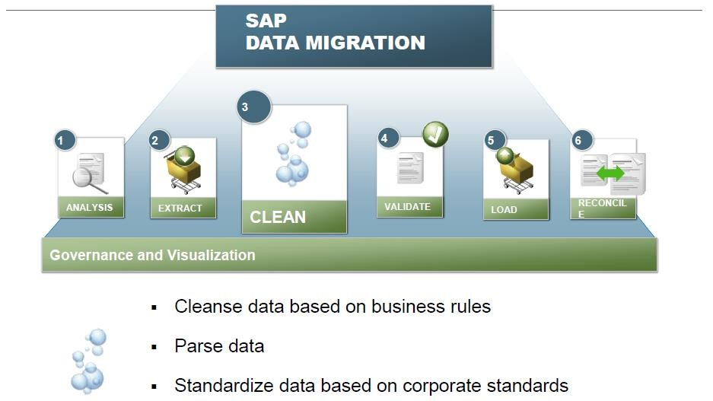
SAP Data Migration solution Clean

Slide 10
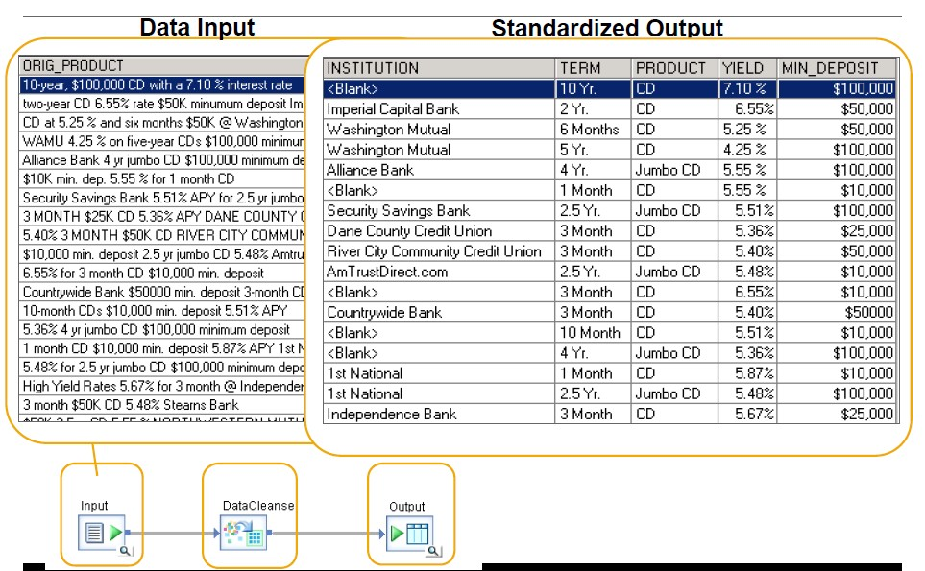
Data cleansing to ensure the right data gets migrated

Slide 11
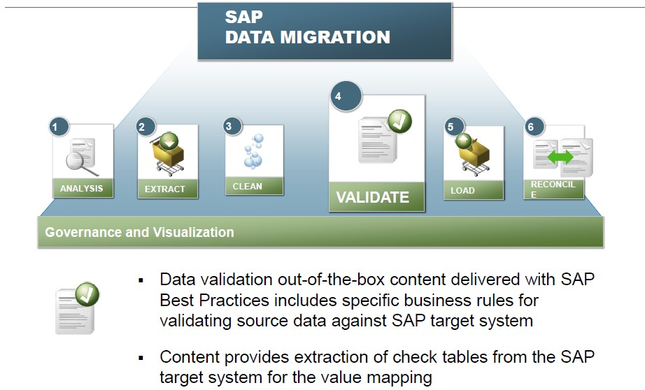
SAP Data Migration solution Validate

Slide 12
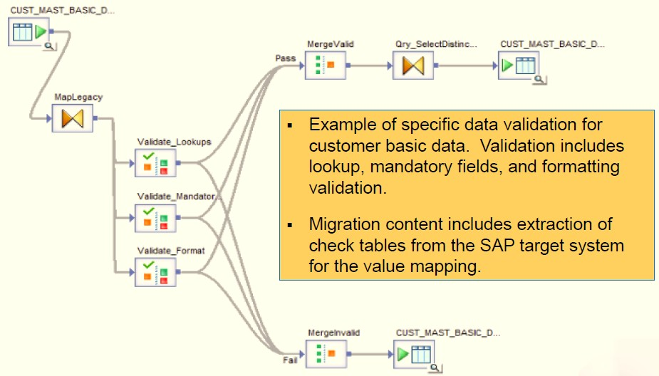
Data validation from source data to target data structures

Slide 13
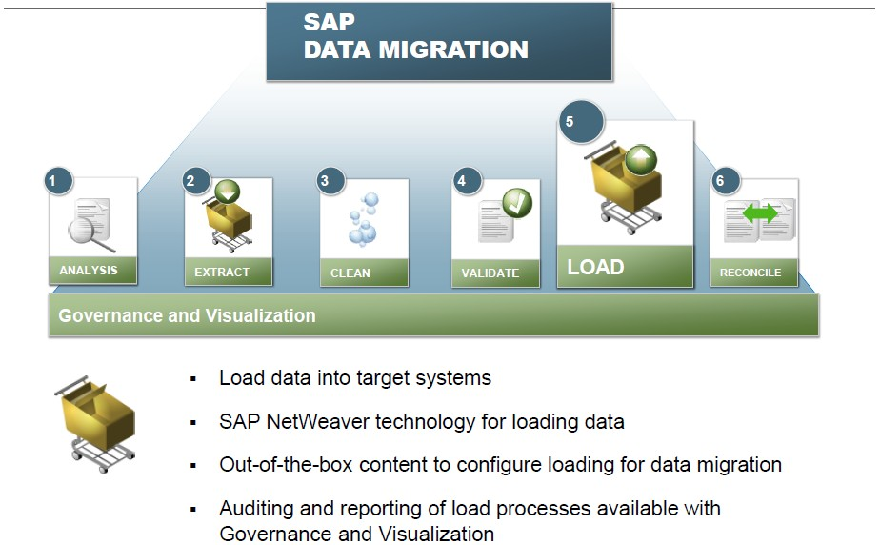
SAP Data Migration solution Load

Slide 14
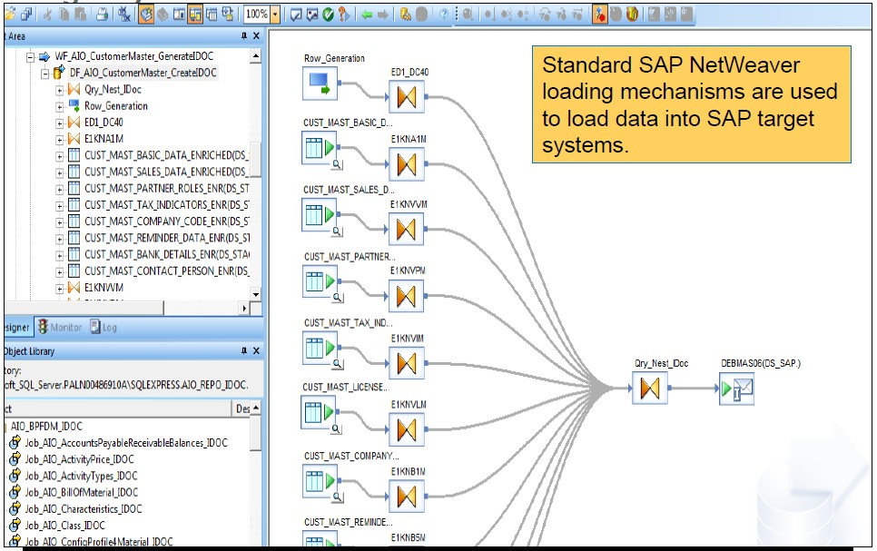
Efficient loading of cleansed and validated source data to target system

Slide 15
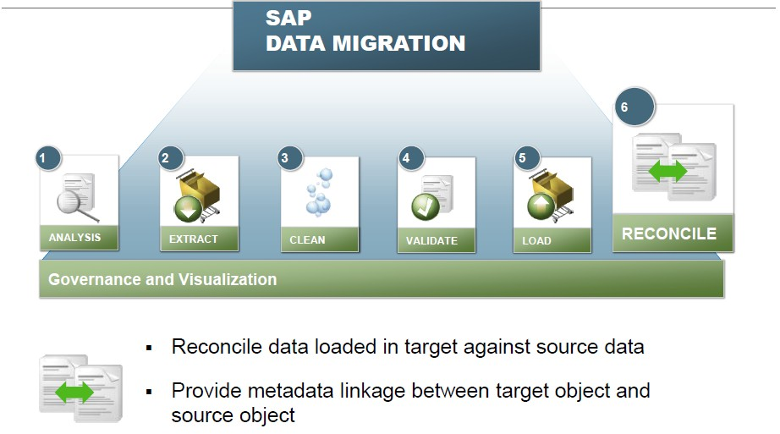
SAP Data Migration solution Reconcile

Slide 16
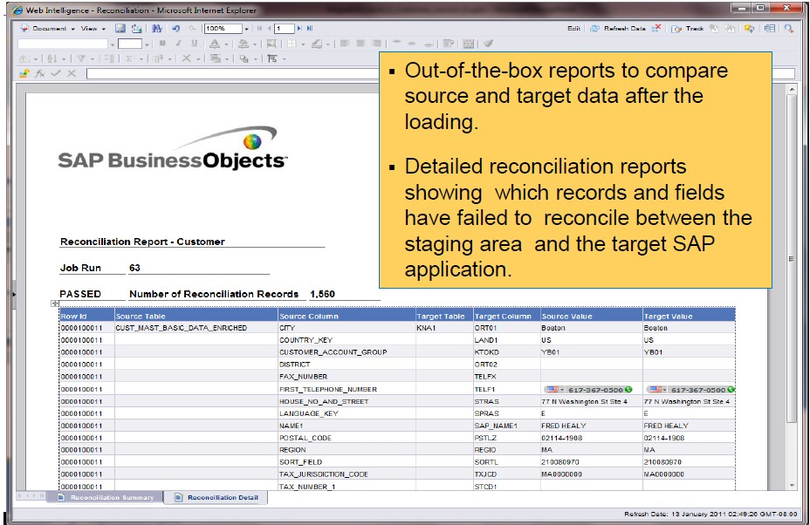
Reconcile to ensure the data was loaded correctly and completely

Slide 17
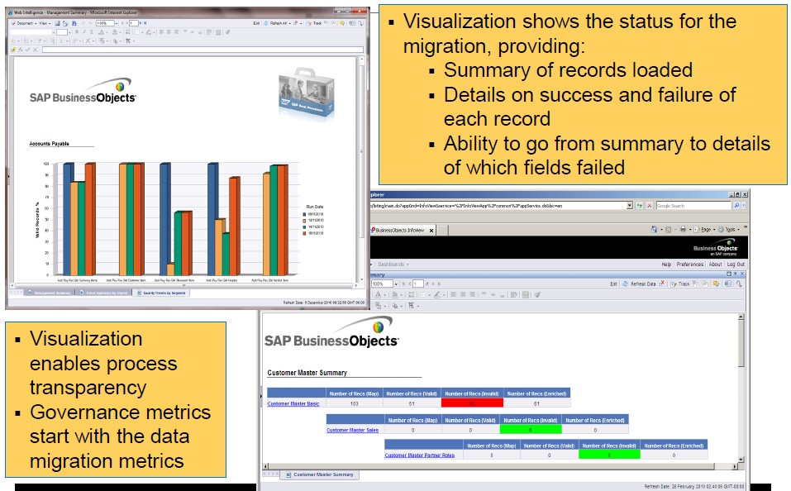
Visualization of the status of the data migration

Slide 18
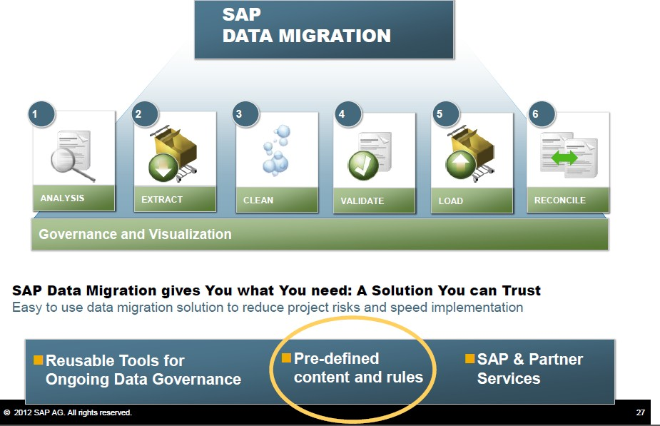
RDS: Rapid data migration
SAP Rapid Deployment Solutions (RDS) are pre-configured applications that allow companies to deploy software in weeks or months for a set price.

Slide 19
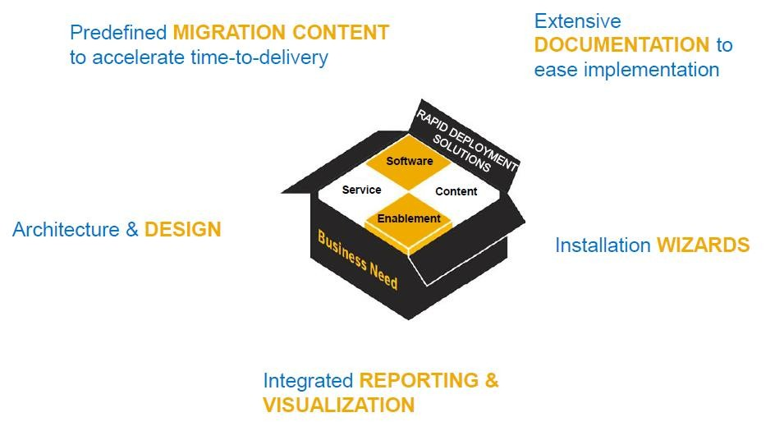
Rapid Development Solutions

Slide 20
RDS Content for Data Migration content provided in SAP Data Services & SAP BI platform
Key Features:
Predefined Migration Content delivered for Data Services
Data validation content enables mapping of customer data to SAP data, including validation of key values. Content for ERP and CRM are included. Examples are:
Business partner content such as customer and vendor masters
Logistics content such as material master, bills of material, documents
Financial content such as receivables, payables, cost elements
Sales content such as activities, leads, opportunities, contracts
purchasing documents, sales

Slide 21
RDS Content for Data Migration content provided in SAP Data Services & SAP BI platform
Documentation
Business Process Document for Data Migration is a process guide that provides a process flow and the sequence in which the objects need to be loaded into Data Services
Extension Guide provides the information you need to extend and modify the content according to your specific needs

Slide 22
DIFFERENT TYPE OF DATA MIGRATION PROCESS
Four major migration categories are proposed on this basis:
1. Storage migration
A business may choose to rationalize the physical media to take advantage of more efficient storage technologies. This will result in having to move physical blocks of data from one tape or disk to another, often using virtualization techniques. The data format and content itself will not usually be changed in the process and can normally be achieved with minimal or no impact to the layers above.

Slide 23
DIFFERENT TYPE OF DATA MIGRATION PROCESS
2. Database migration
Similarly, it may be necessary to move from one database vendor to another, or to upgrade the version of database software being used. The latter case is less likely to require a physical data migration, but this can happen with major upgrades. In these cases a physical transformation process may be required since the underlying data format can change significantly.

Slide 24
DIFFERENT TYPE OF DATA MIGRATION PROCESS
3. Application migration
Changing application vendor – for instance a new CRM or ERP platform – will inevitably involve substantial transformation as almost every application or suite operates on its own specific data model and also interacts with other applications and systems within the enterprise integration environment.

Slide 25
DIFFERENT TYPE OF DATA MIGRATION PROCESS
4. Business process migration
Business processes operate through a combination of human and application systems actions, often orchestrated by business process management tools. When these change they can require the movement of data from one store, database or application to another to reflect the changes to the organization and information about customers, products and operations. Examples of such migration drivers are mergers and acquisitions, business optimization and reorganization to attack new markets or respond to competitive threat.

Slide 26


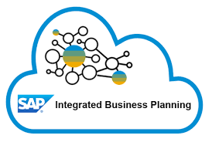
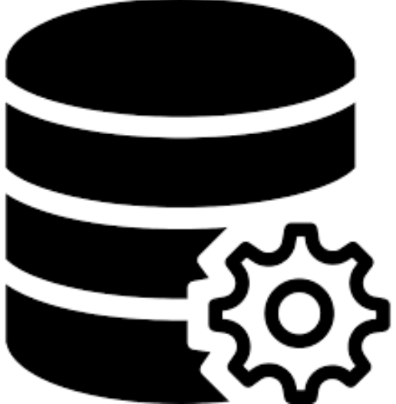

Accelerated S/4HANA data migration powered by DataPath
Legacy source
Data quality management
Data-migration design, development, and testing
S/4HANA platform
SAP systems
Data-readiness assessment
iCAPDQ
3
Data-mapping
Accelerator by
Industry Path
Data-quality dashboards
using SAP IS
Data-validation scripts
1
2
5
Data quality assessment
Data
mapping
Transform
Load
Validate
Target systems
Extract and profile
Data cleansing
Consolidation
Non-SAP systems
Data enrichment
Technology solution
Accelerated solutions
4
Migration cockpit
S/4HANA
Staging
Legacy
staging
6
Audit and reconciliation
Capgemini proprietary enablers for data migration
1
Data readiness assessment
2
iCAPDQ SAP IS solution
3
Migration objects by industry path
4
Automated Load program generation tailored to data objects
5
DQ and profiling dashboards
6
Data reconciliation automation

Slide 27
Thank You

